Slide 1
Budget wise AI
Based expense
forecasting too
🔮 Advanced AI Forecasting + 🎯 Smart Goal Management

Slide 2
🎯 MILESTONE 3 OBJECTIVES
✅ Advanced Expense Forecasting Engine
✅ Financial Goal Creation & Tracking
✅ AI-Powered Goal Coaching
✅ Savings Progress Management
✅ Multi-Category Forecasting
✅ Forecast Performance Analytics

Slide 3
🔮 ADVANCED FORECASTING ENGINE
✅ Prophet AI integration with fallback
✅ Multi-category expense predictions
✅ Anomaly detection in spending
✅ Confidence interval calculations
✅ Seasonal trend analysis
New Endpoints:
• POST /forecast - Generate predictions
• GET /forecast/categories - Available categories
• POST /forecast/compare - Multi-category analysis
• GET /forecast/performance - Model metrics

Slide 4
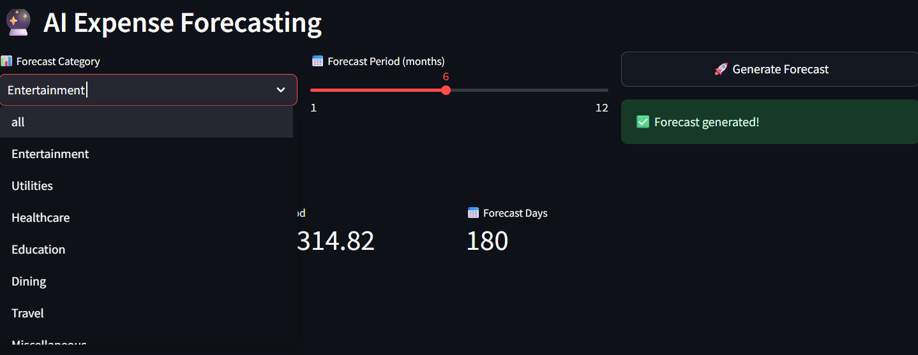
🔮 ADVANCED FORECASTING ENGINE

Slide 5
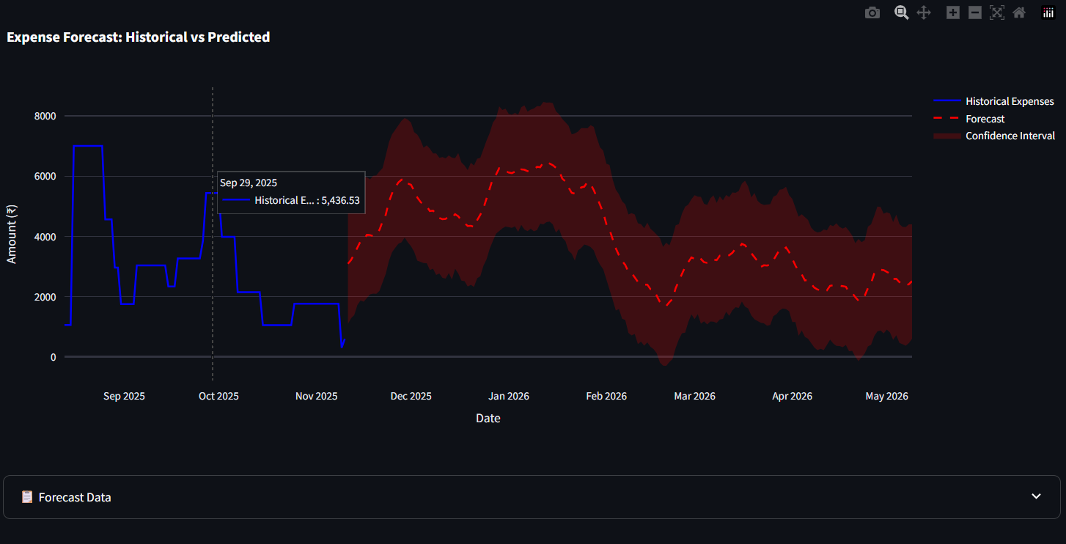
🔮 ADVANCED FORECASTING ENGINE

Slide 6
🎯 GOAL MANAGEMENT SYSTEM
✅ Create savings/spending reduction goals
✅ Track progress with visual indicators
✅ Add savings contributions to goals
✅ Goal status tracking (active/achieved/overdue)
✅ Days remaining calculations
New Endpoints:
• POST /goals - Create goals
• GET /goals - List user goals
• DELETE /goals/{id} - Remove goals
• POST /goals/{id}/savings - Add savings

Slide 7
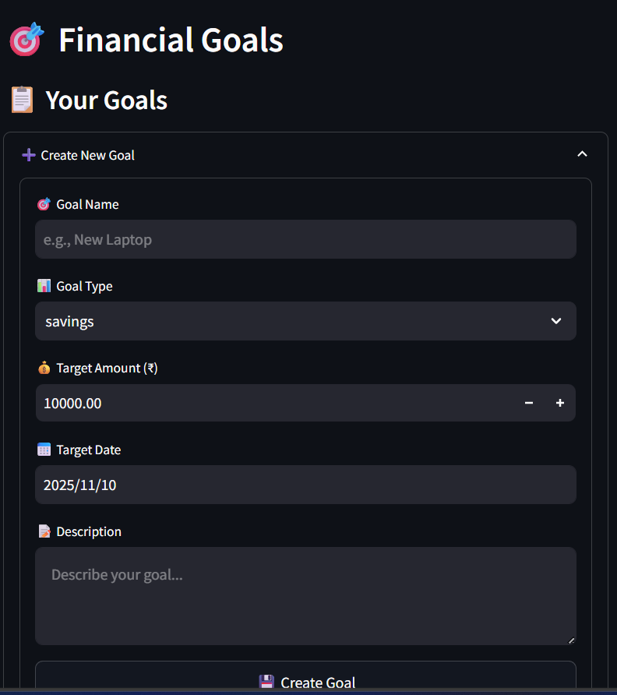
🎯 GOAL MANAGEMENT SYSTEM

Slide 8

🤖 AI GOAL COACHING
✅ Financial situation analysis
✅ Success probability calculations
✅ Personalized action plans
✅ Realistic feasibility scoring
✅ Spending optimization recommendations
Features:
• Monthly income/expense analysis
• Savings capacity assessment
• Timeline adjustments
• Achievement probability estimates

Slide 9
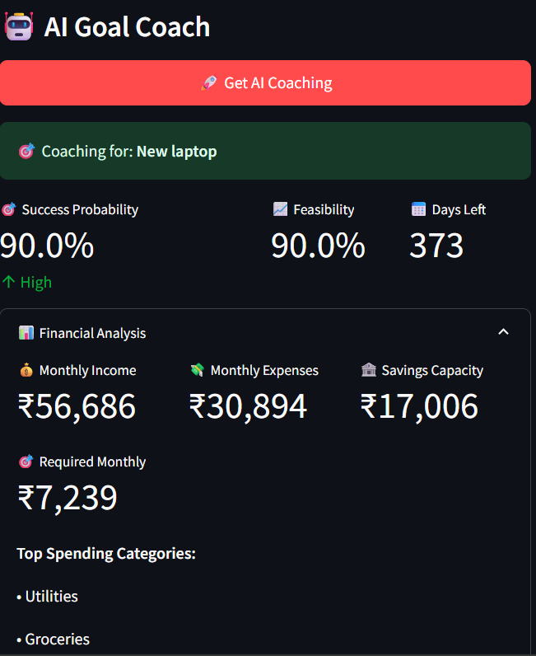
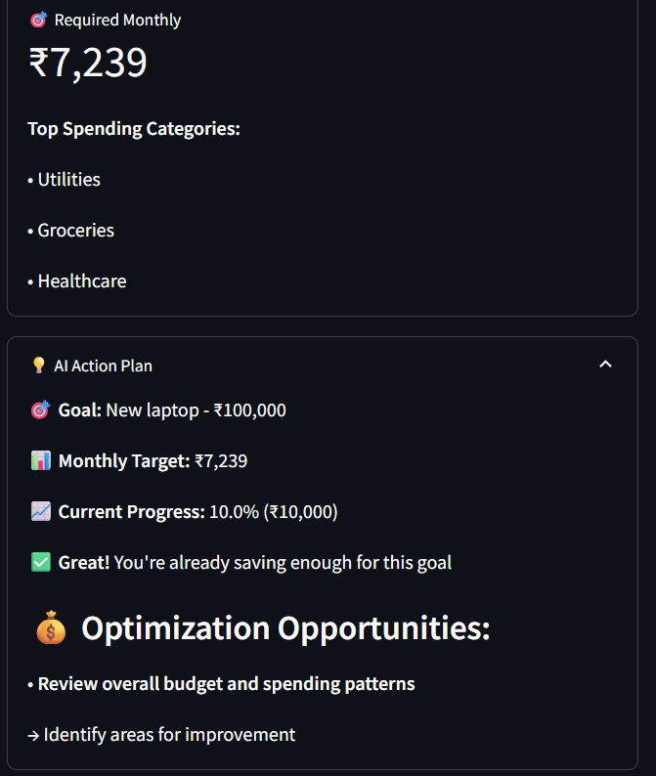
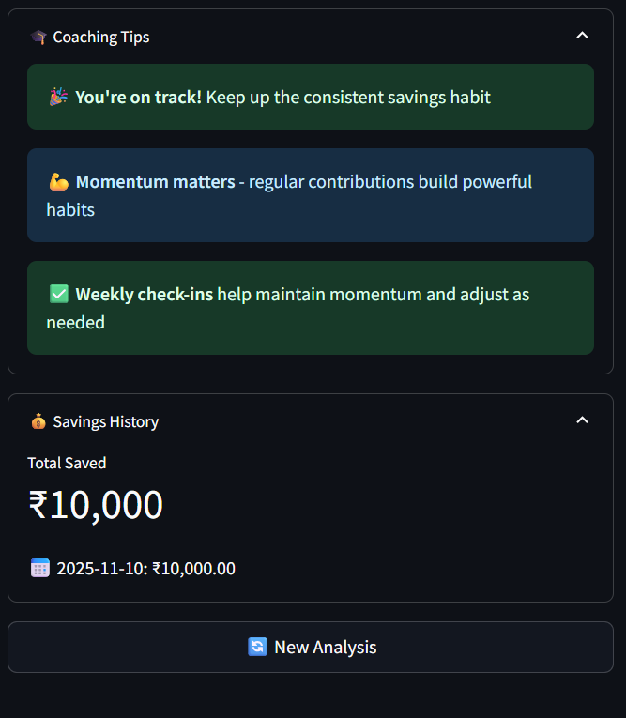
🤖 AI GOAL COACHING

Slide 10
💰 NEW: SAVINGS TRACKING
✅ Track individual savings contributions
✅ Savings history with dates/descriptions
✅ Real-time progress updates
✅ Goal completion detection
Frontend Integration:
• Savings entry interface
• Progress visualization
• Historical savings view

Slide 11
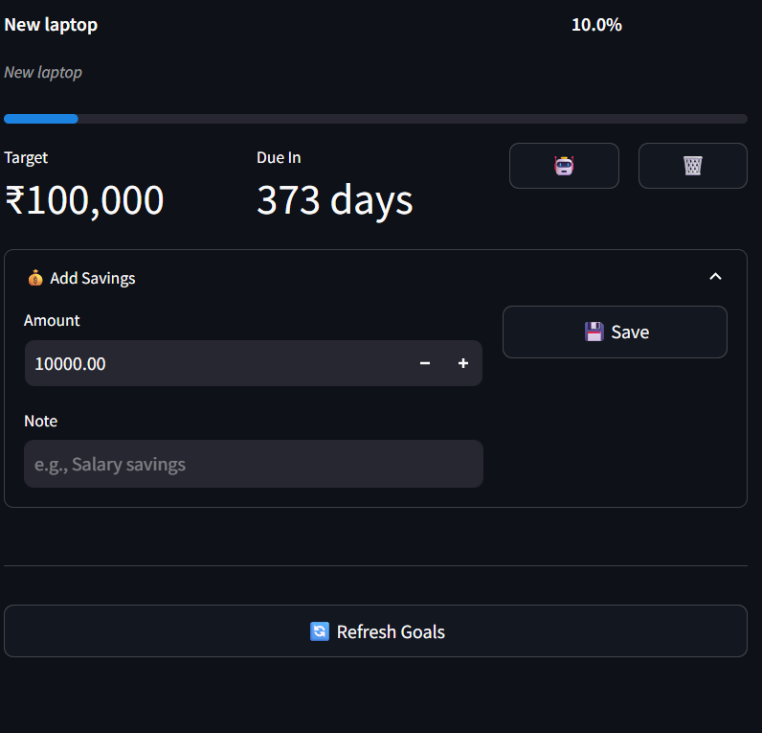
💰 NEW: SAVINGS TRACKING

Slide 12

🔧 DATABASE ENHANCEMENTS
New Tables in init_db.sql:
• financial_goals - Goal definitions & progress
• goal_savings - Individual savings entries
Enhanced Schema:
• Goal type enforcement
• Progress tracking fields
• Timestamp automation
• Foreign key relationships

Slide 13
🎯 MILESTONE 3 COMPLETION SUMMARY
New Backend Features:
✅ Advanced forecasting with Prophet AI
✅ Complete goal management system
✅ AI-powered financial coaching
✅ Savings tracking & progress monitoring
New Frontend Features:
✅ Forecasting dashboard & visualizations
✅ Goal creation & tracking interface
✅ AI coaching results display
✅ Savings management interface

Slide 14
Technical Achievements:
• 15+ new API endpoints
• 2 new database tables
• Advanced caching system
• Real-time progress tracking

Slide 15
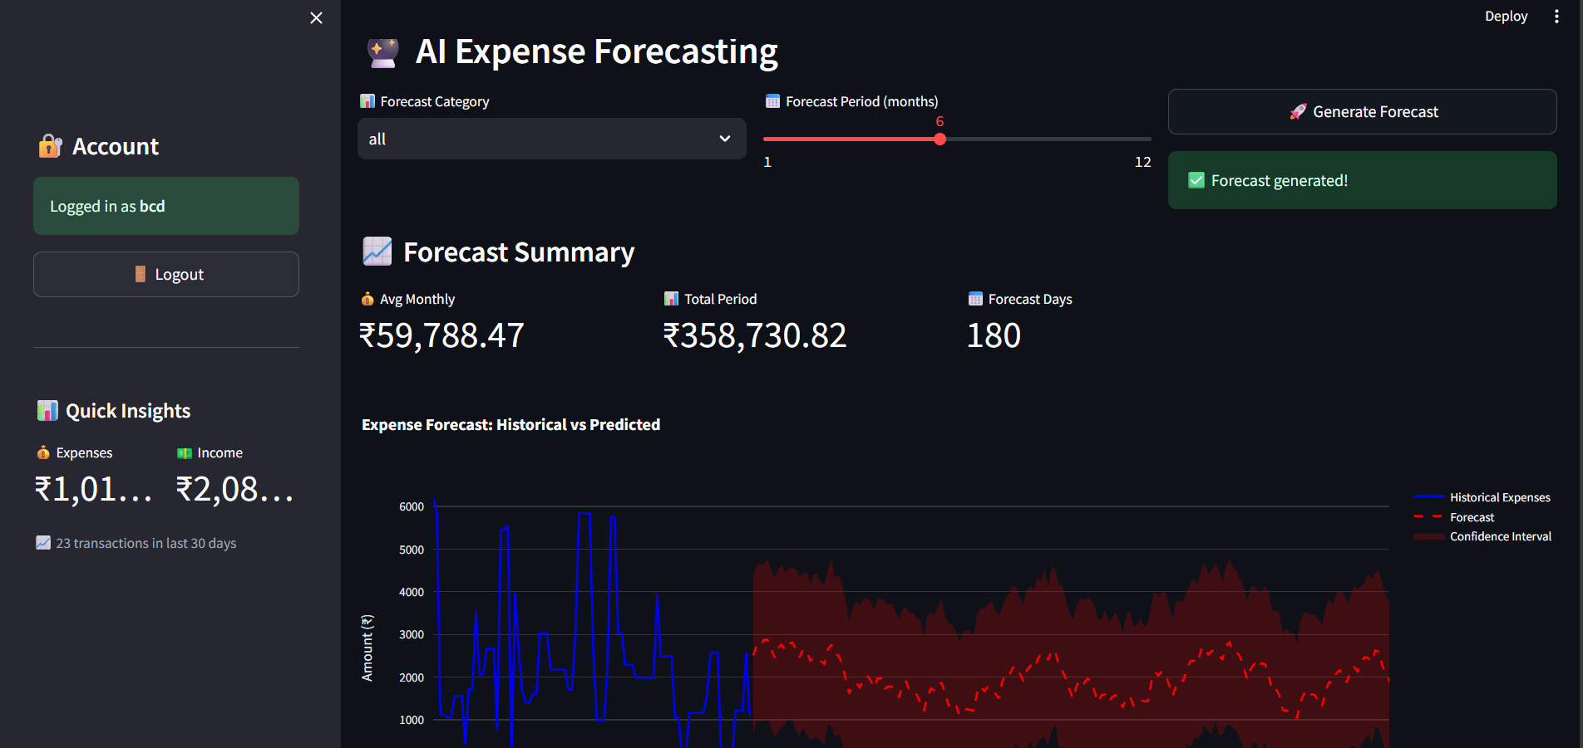
Overall View

Slide 16
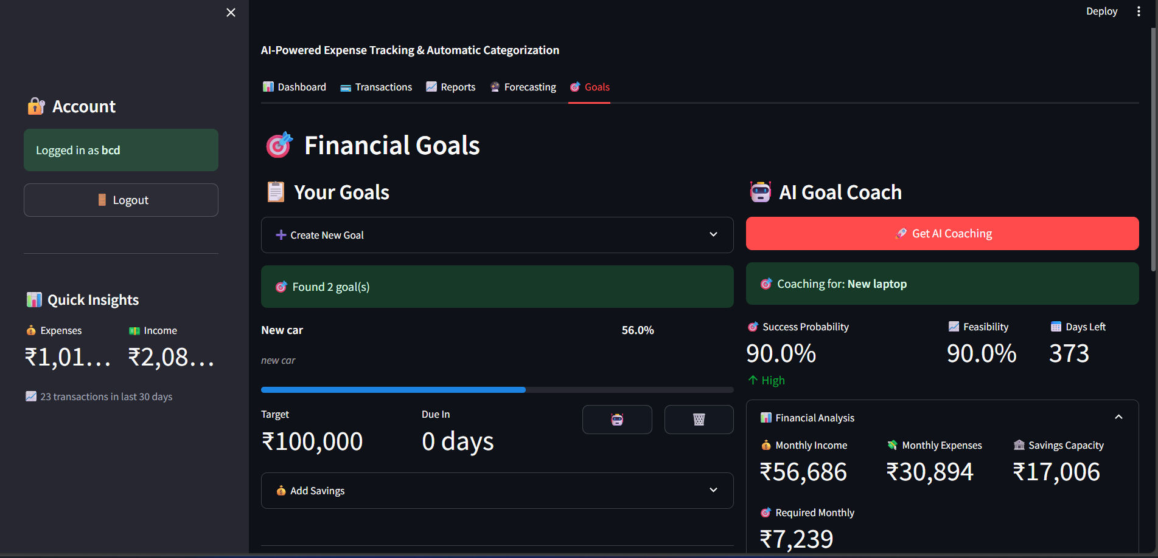
Overall View

